Slide 1
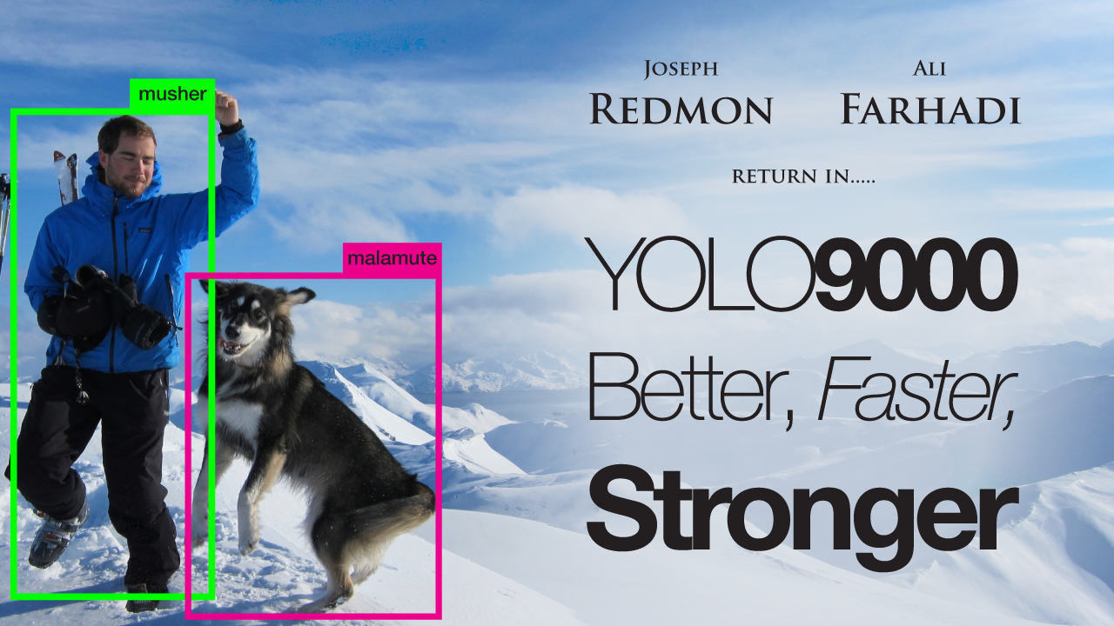

Slide 2
 | Pascal 2007 mAP | Speed
DPM v5 | 33.7 | .07 FPS | 14 s/img
R-CNN | 66.0 | .05 FPS | 20 s/img
Fast R-CNN | 70.0 | .5 FPS | 2 s/img
Faster R-CNN | 73.2 | 7 FPS | 140 ms/img
YOLO | 63.4 | 45 FPS | 22 ms/img

Slide 3

 | Pascal 2007 mAP | Speed
DPM v5 | 33.7 | .07 FPS | 14 s/img
R-CNN | 66.0 | .05 FPS | 20 s/img
Fast R-CNN | 70.0 | .5 FPS | 2 s/img
Faster R-CNN | 73.2 | 7 FPS | 140 ms/img
YOLO | 63.4 | 45 FPS | 22 ms/img

Slide 4

 | Pascal 2007 mAP | Speed
DPM v5 | 33.7 | .07 FPS | 14 s/img
R-CNN | 66.0 | .05 FPS | 20 s/img
Fast R-CNN | 70.0 | .5 FPS | 2 s/img
Faster R-CNN | 73.2 | 7 FPS | 140 ms/img
YOLO | 63.4 | 45 FPS | 22 ms/img

Slide 5
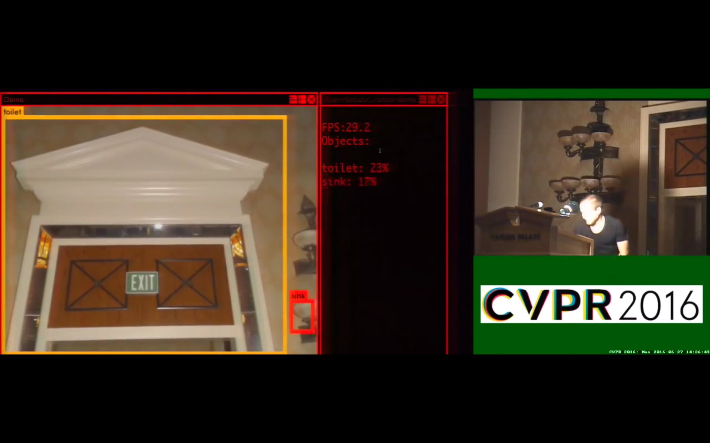

Slide 6


Slide 7


Slide 8
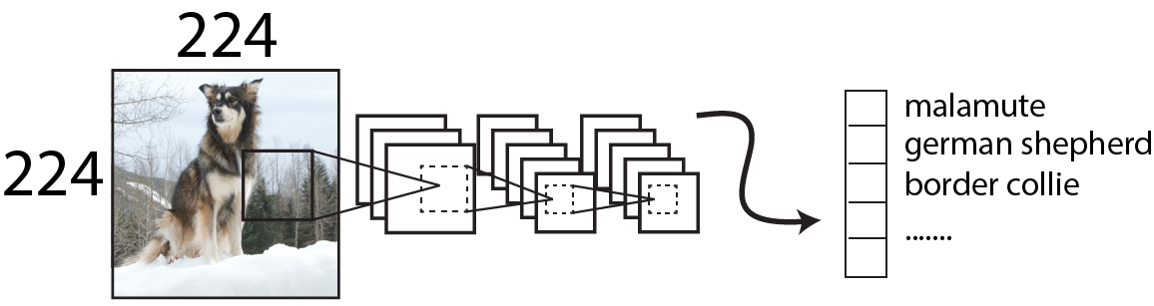
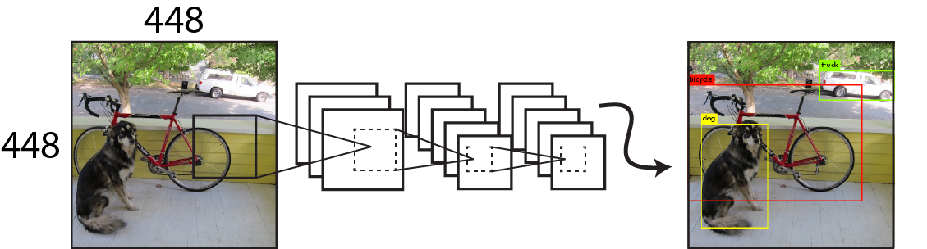
Train on ImageNet
Resize network
Fine-tune on detection

Slide 9
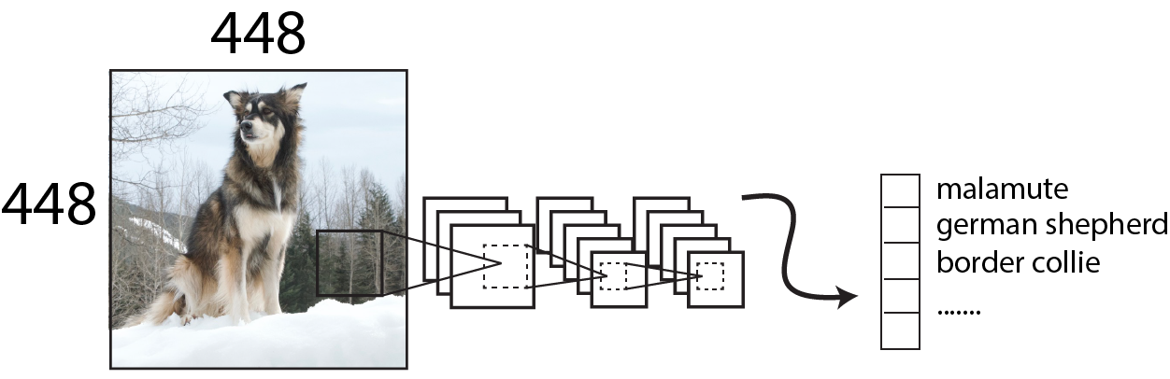
Fine-tune 448x448 Classifier: +3.5% mAP
Train on ImageNet
Resize, fine-tune
on ImageNet
Fine-tune on detection

Slide 10
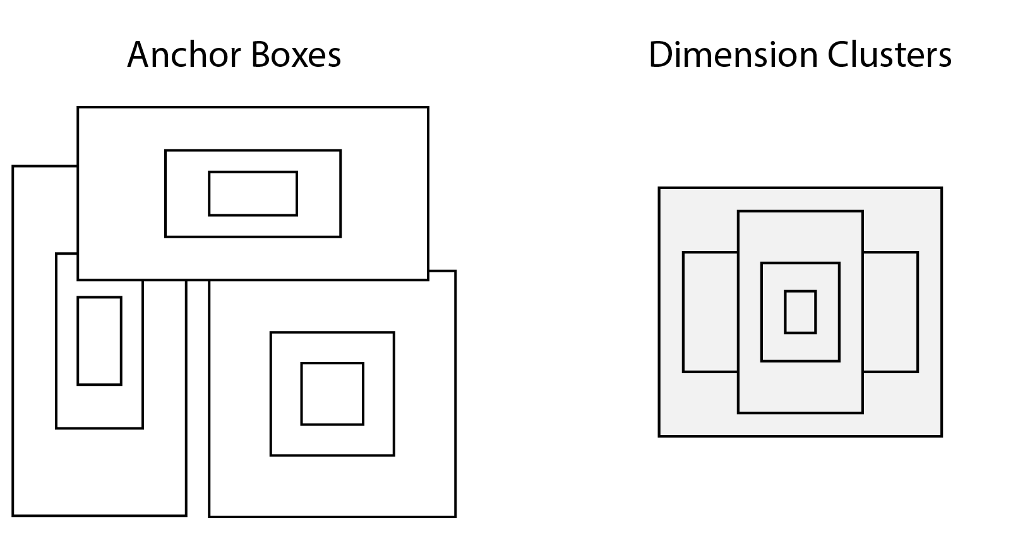

Slide 12
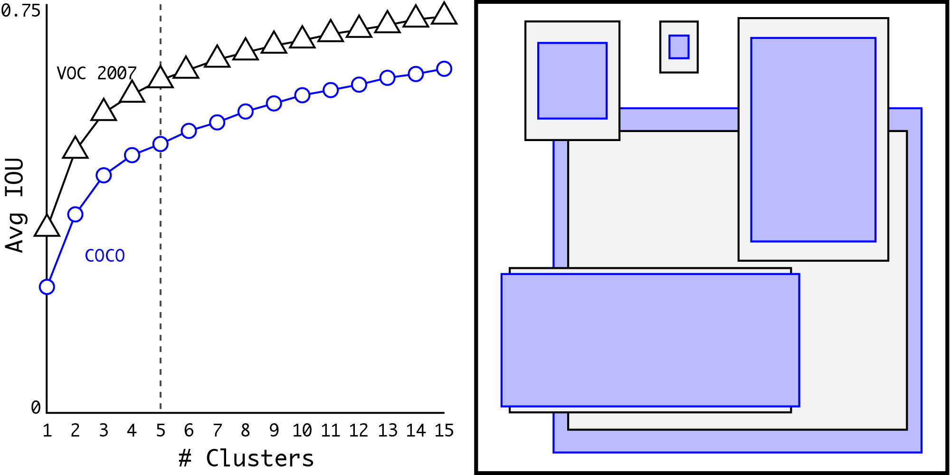

Slide 13
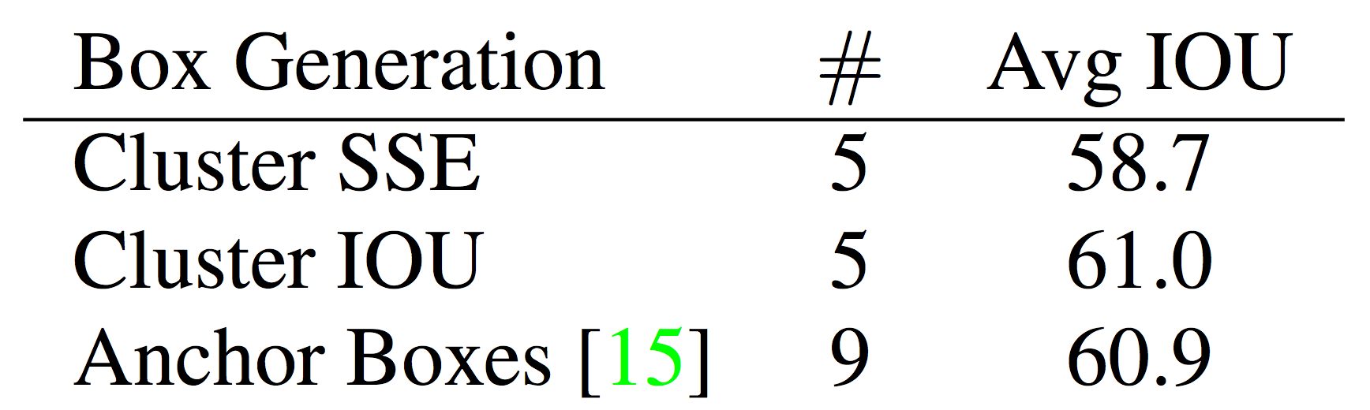
Dimension Clusters: +5% mAP

Slide 14
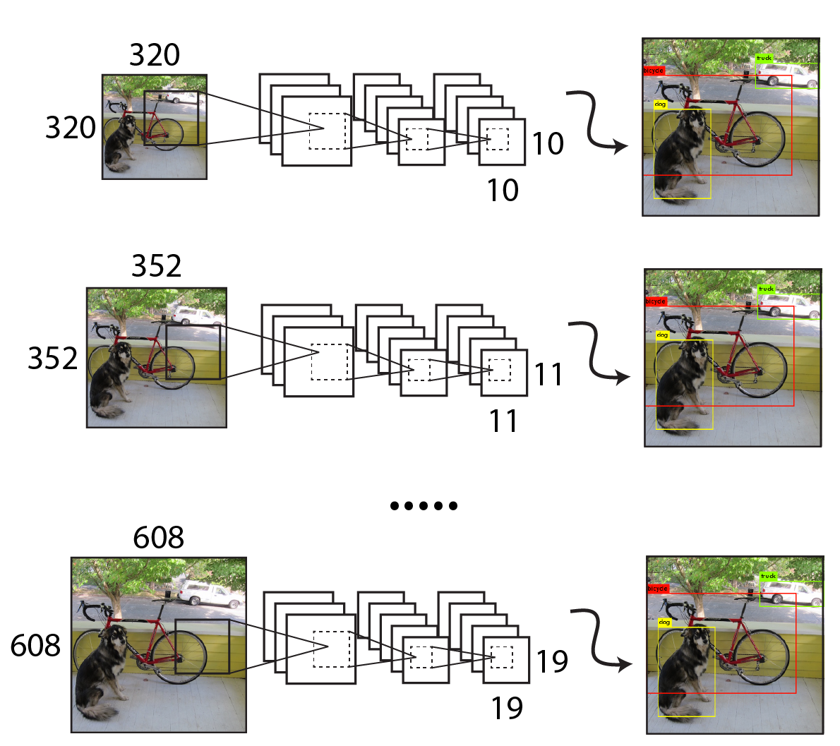
Multi-scale training: +1.5% mAP

Slide 15
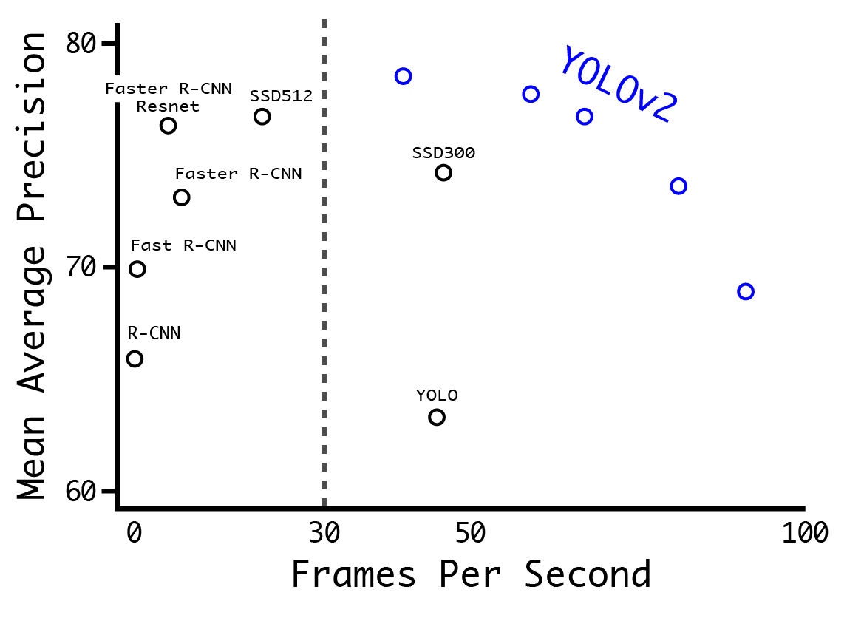
YOLOv2: Fast, Accurate Detection

Slide 16


Slide 17
Speed is not just FLOPS!!
 | Top 1 | Top 5 | FLOPs | GPU Speed
VGG-16 | 70.5 | 90.0 | 30.95 Bn | 100 FPS
Extraction (YOLOv1) | 72.5 | 90.8 | 8.52 Bn | 200 FPS
Resnet50 | 75.3 | 92.2 | 7.66 Bn | 90 FPS

Slide 18
Speed is not just FLOPS!!
 | Top 1 | Top 5 | FLOPs | GPU Speed
VGG-16 | 70.5 | 90.0 | 30.95 Bn | 100 FPS
Extraction (YOLOv1) | 72.5 | 90.8 | 8.52 Bn | 200 FPS
Resnet50 | 75.3 | 92.2 | 7.66 Bn | 90 FPS
Darknet19 | 74.0 | 91.8 | 5.58 Bn | 200 FPS

Slide 19
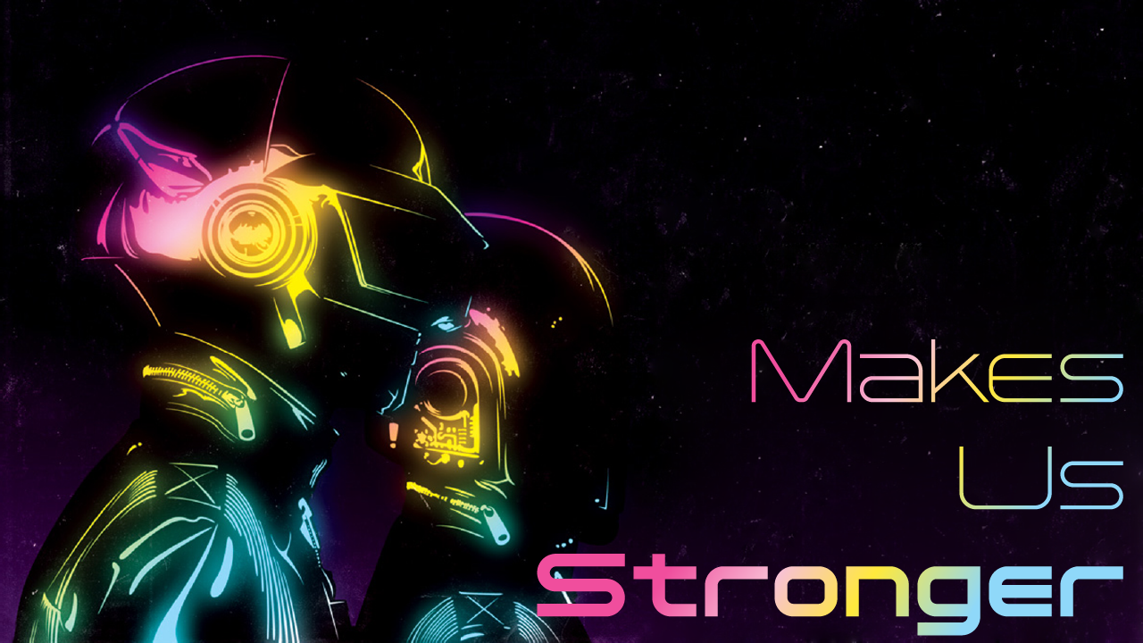

Slide 21
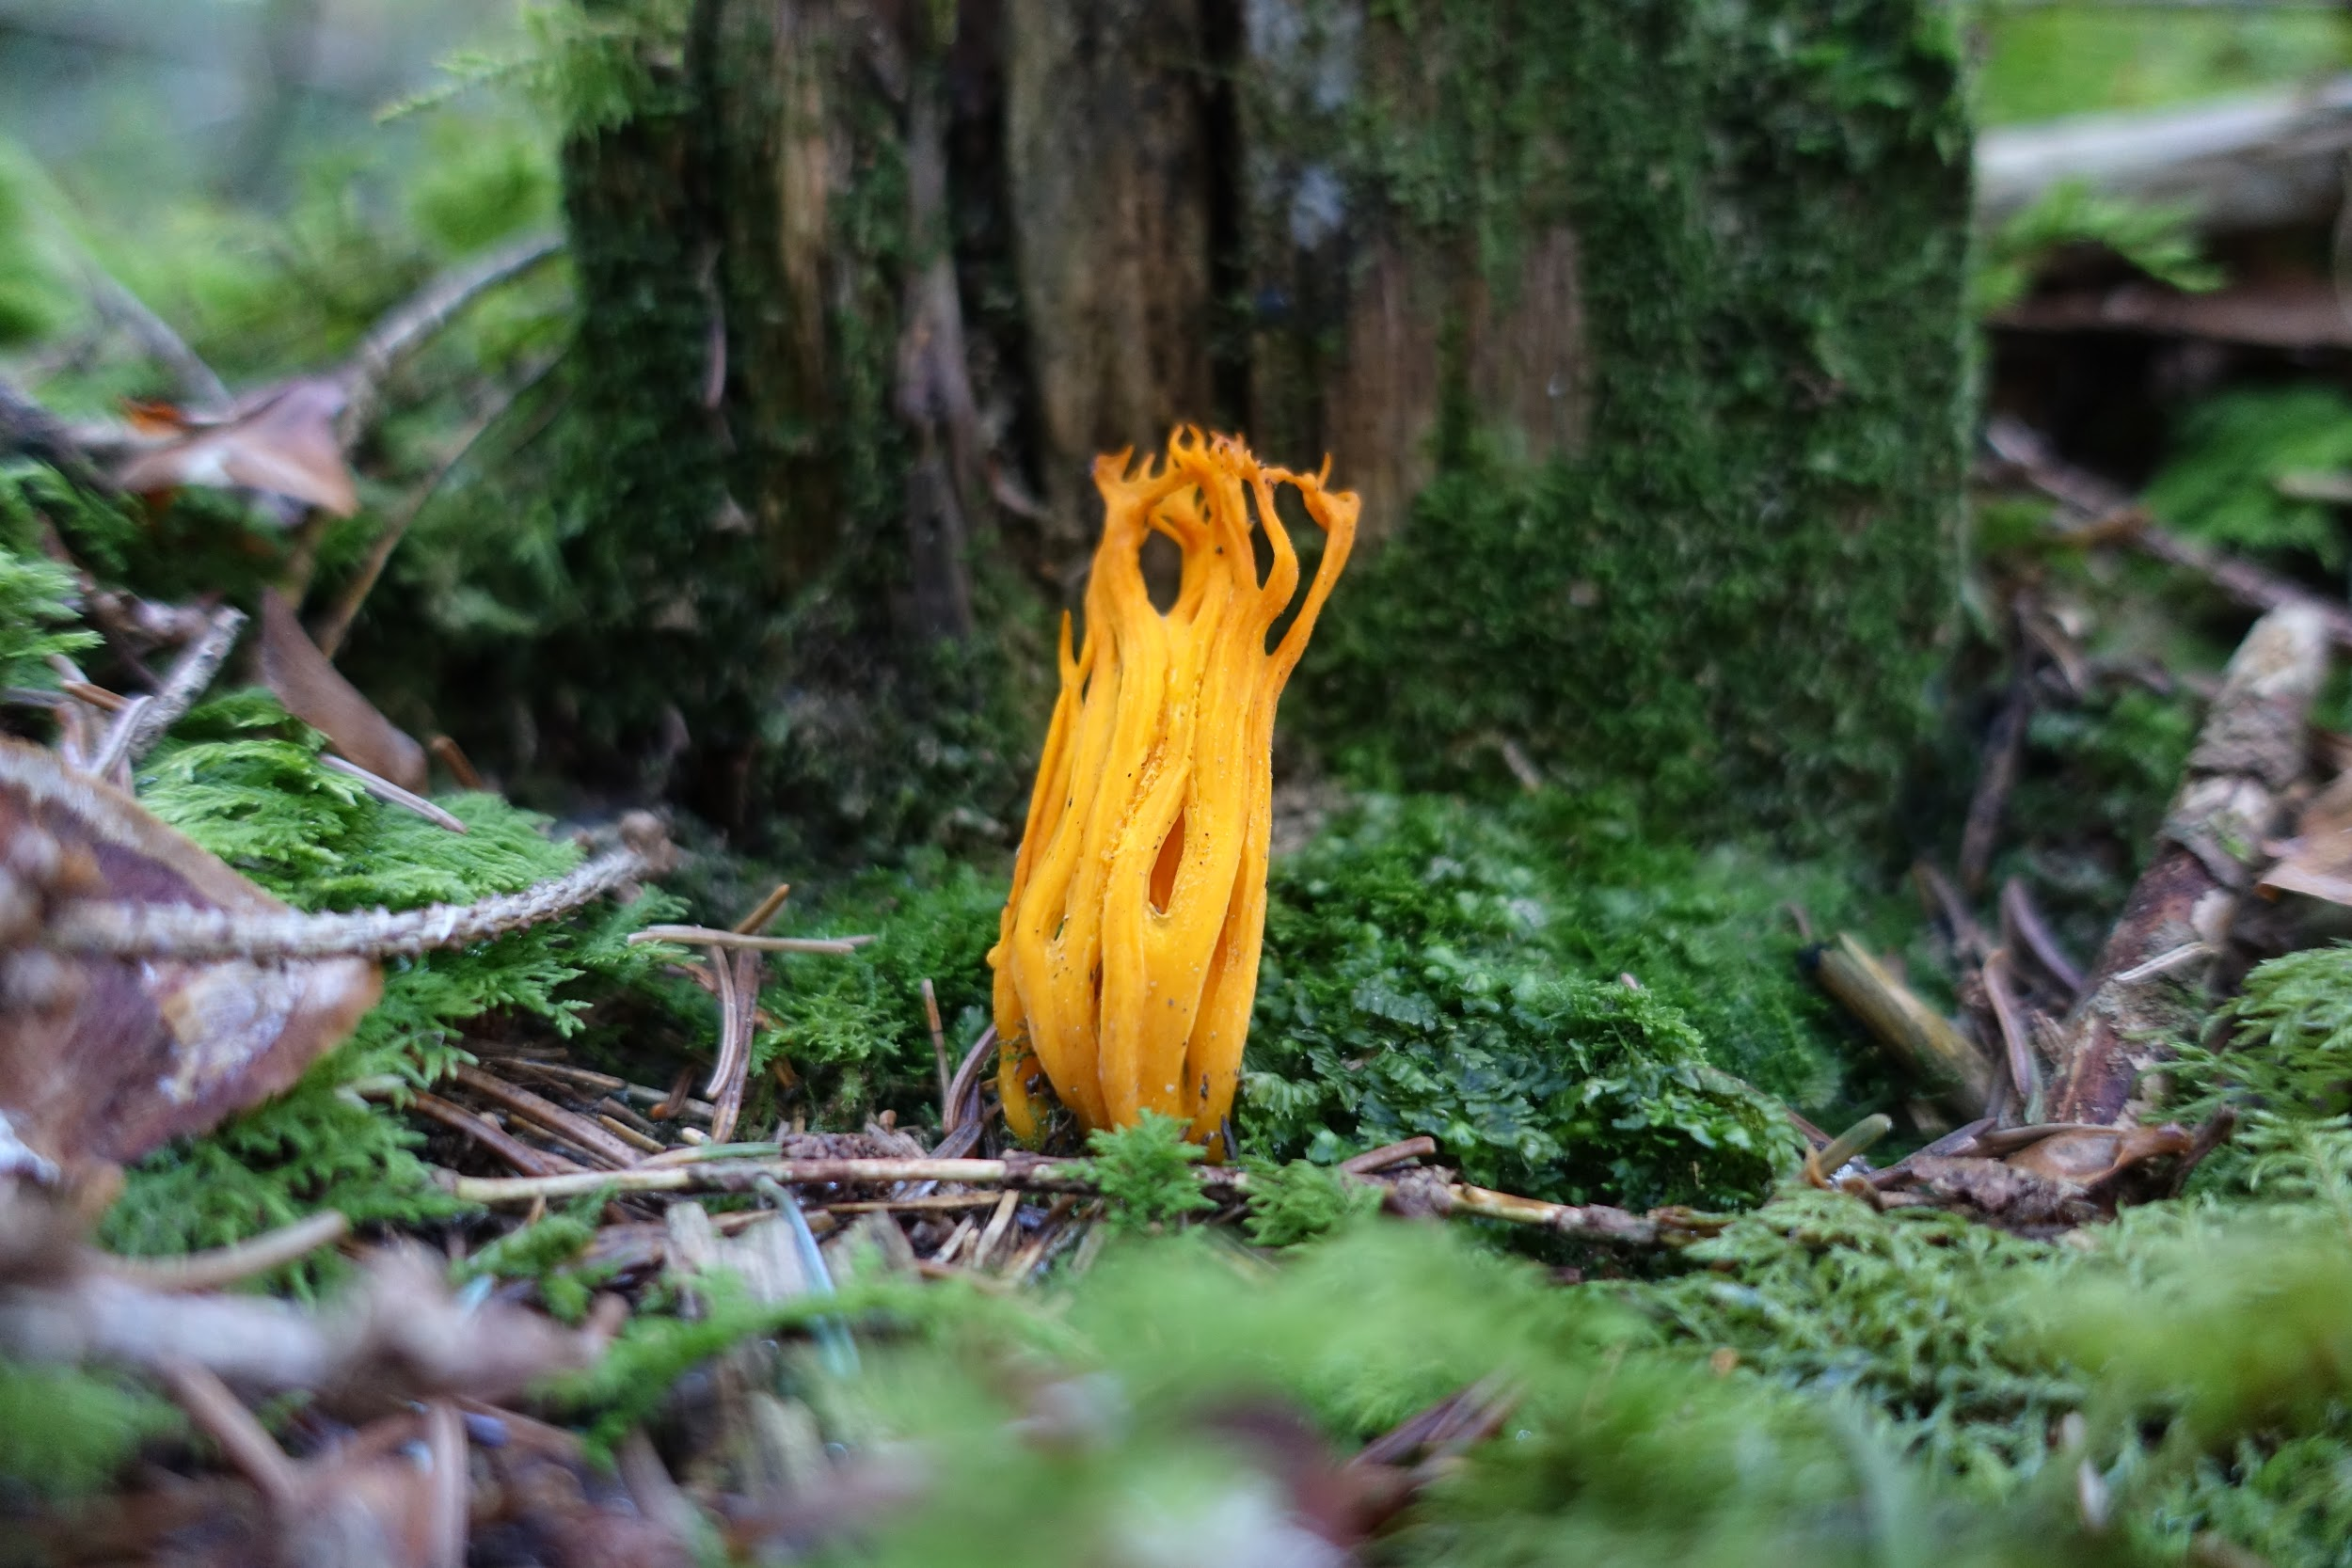

Slide 22
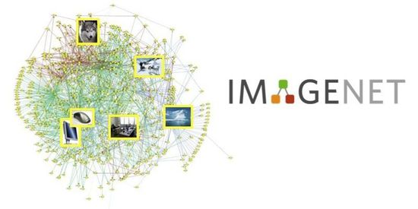

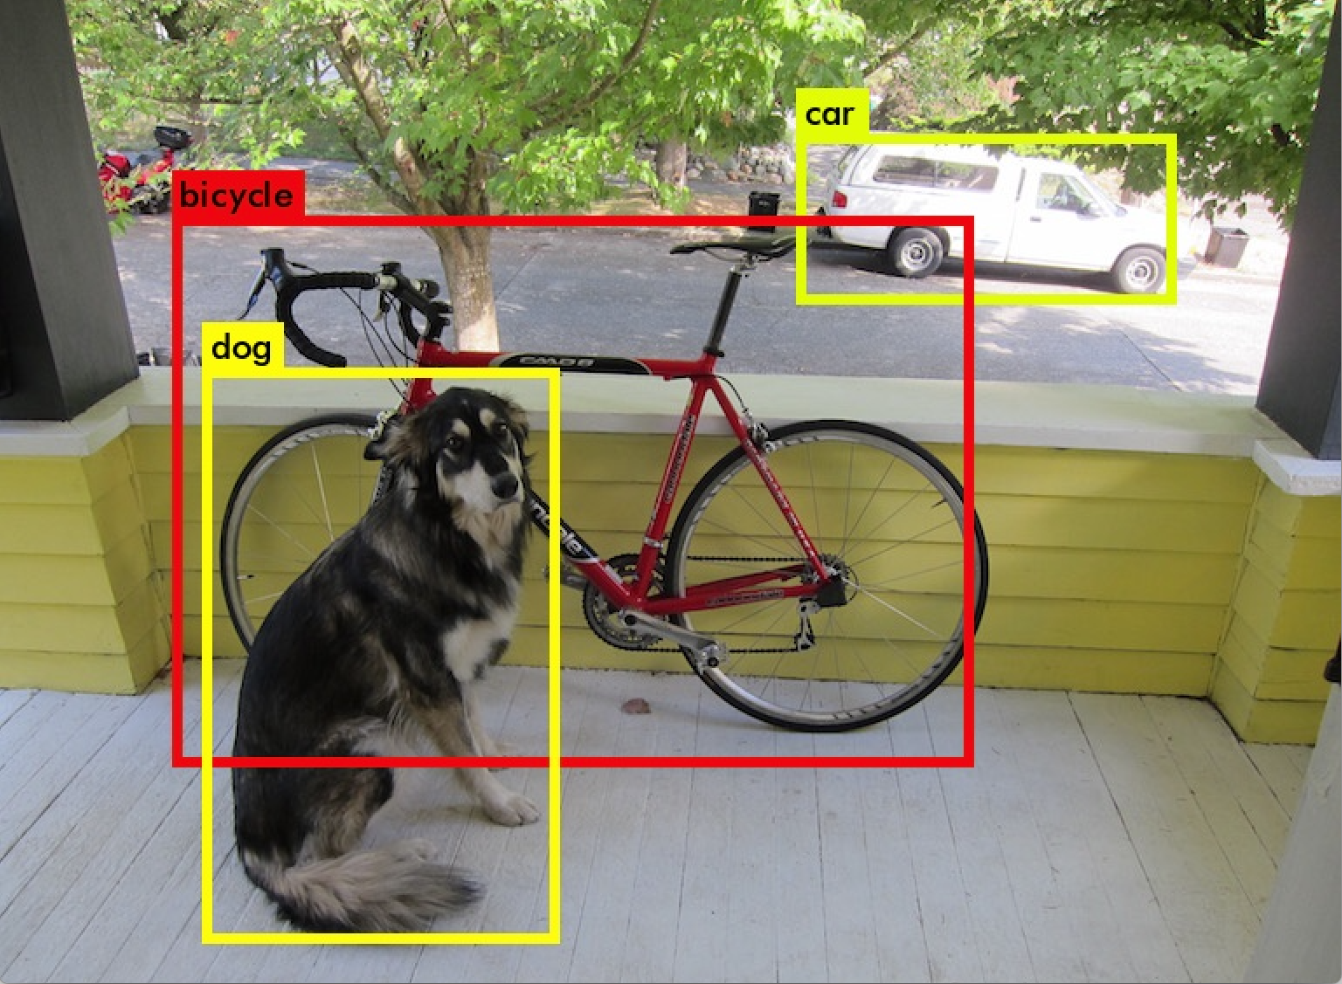
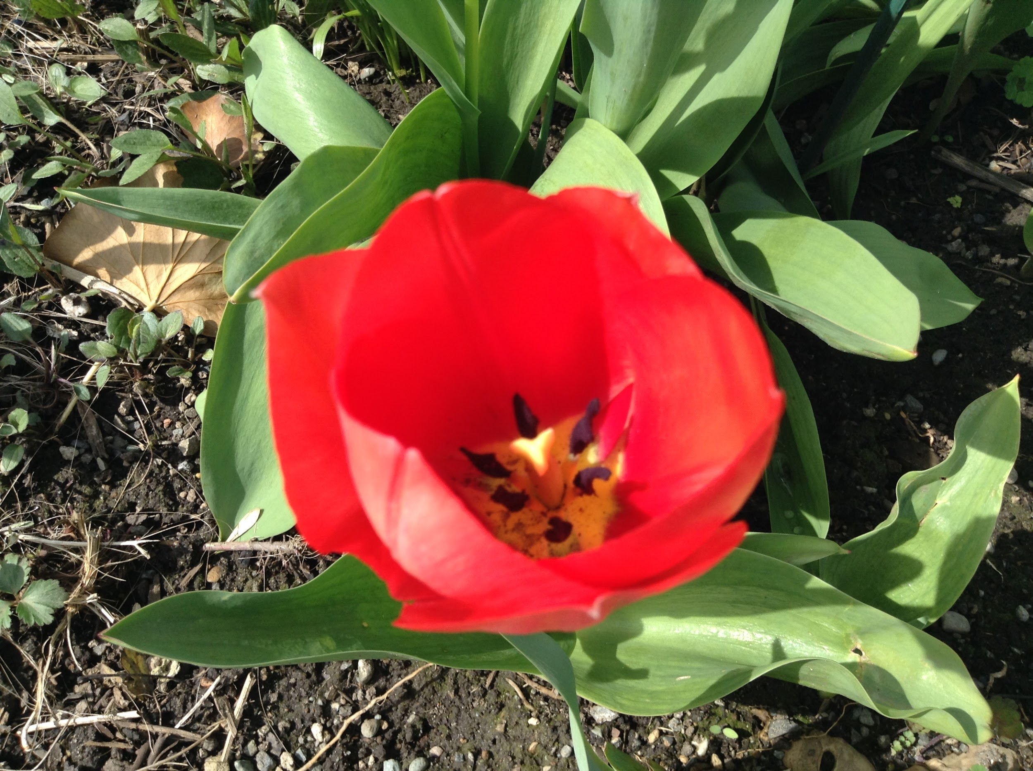
100k images
80 classes
Detection labels
14 million images
22k classes
Classification labels
Tulipa gesneriana

Slide 23
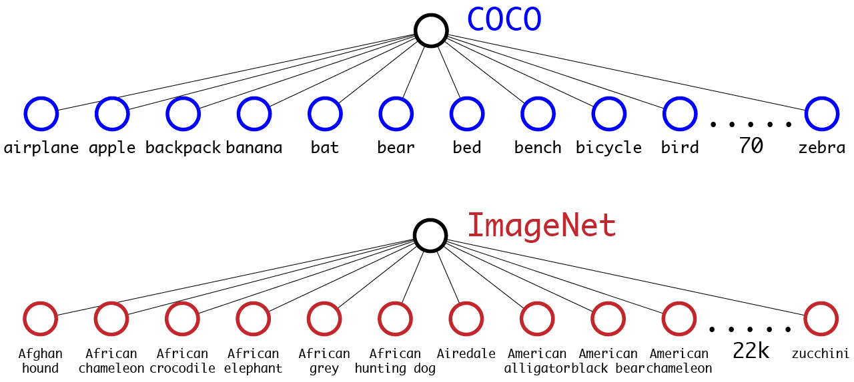
Typically use softmax over all classes

Slide 24
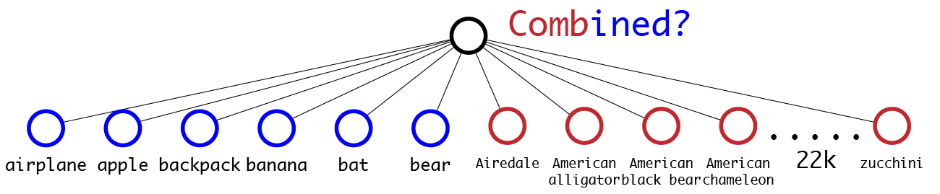
Can’t just mash classes together...

Slide 25

Can’t just mash classes together...

Slide 26
Can’t just mash classes together...

Slide 27

Can’t just mash classes together...

Slide 28
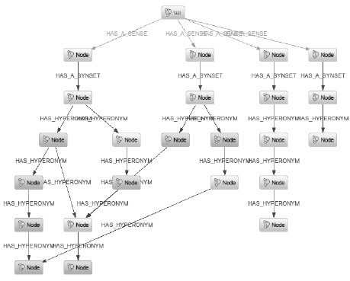
WordNet has structure but it’s messy

Slide 29
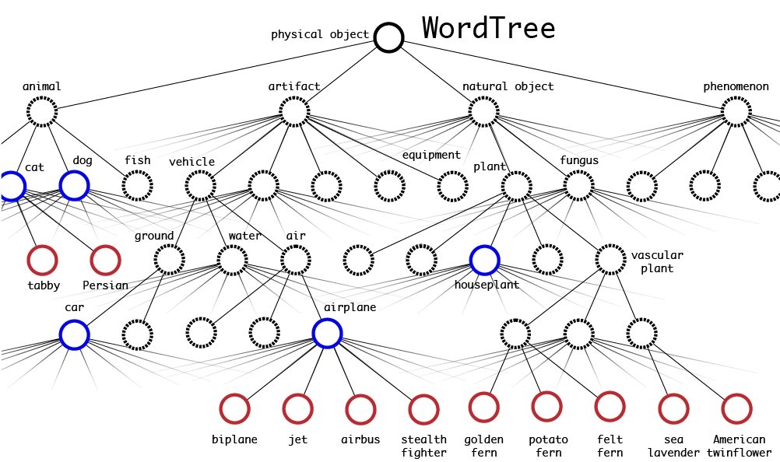

Slide 30
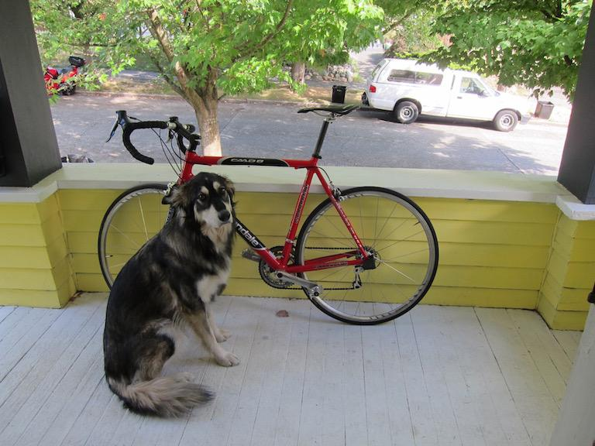
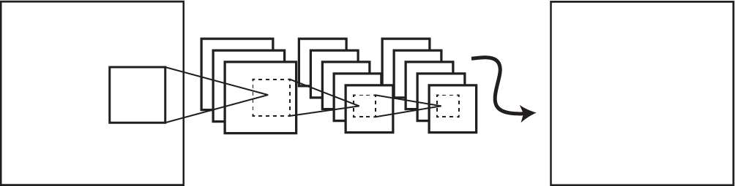
Detection + Classification Error
Tulipa gesneriana
Classification Error

Slide 31
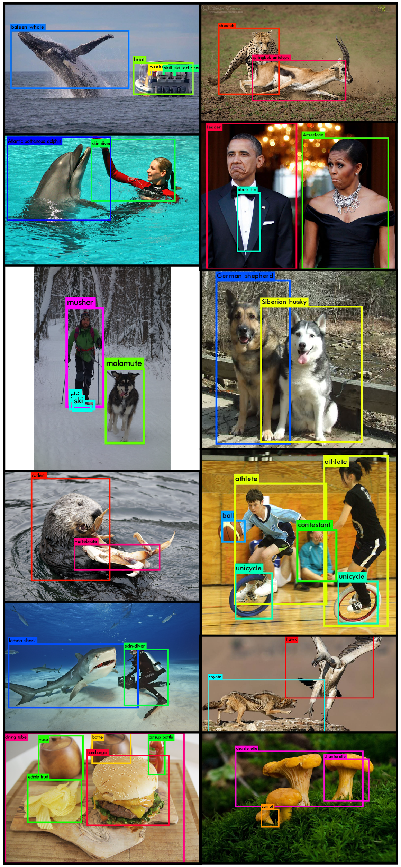

Slide 32


Slide 33
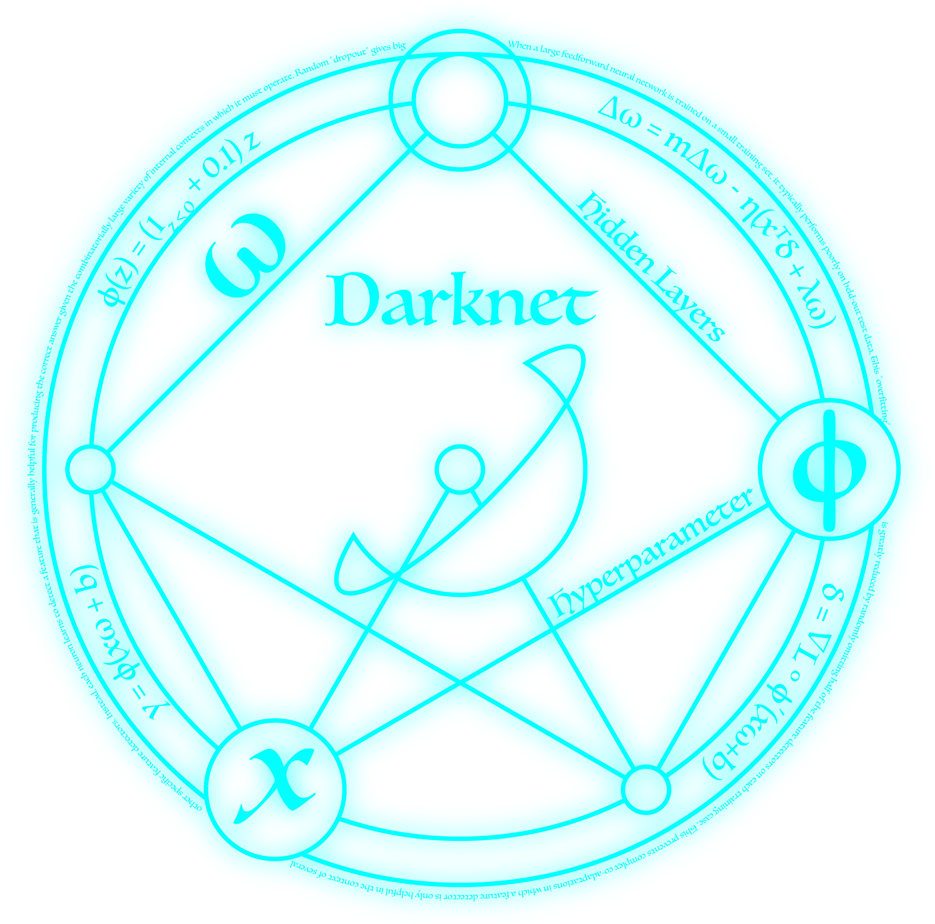
Code, models, and updates:
https://pjreddie.com/yolo/

